Slide 1
Computational Quantum Mechanics
Prof. Gerson J. Ferreira
INFIS/UFU 2020/1
Variational Monte-Carlo
https://gitlab.com/gersonjferreira/computational-quantum-mechanics

Slide 2
The variational method
Let’s assume H has the spectrum→ where E0 corresponds to the lowest energy, all states satisfy
E
E0
E1
E2
E3
E4
...
Any other trial wave-function can be
written as a linear combination→
of the eigenstates,
and its energy is
> 0

Slide 3
Local minima
Assuming:
Consider the effects of an infinitesimal change ψ+δψ, and neglect (δψ)² corrections
Neglect (δψ)² corrections again to get
But if ψ is the eigenstate with energy E, then δE = 0

Slide 4


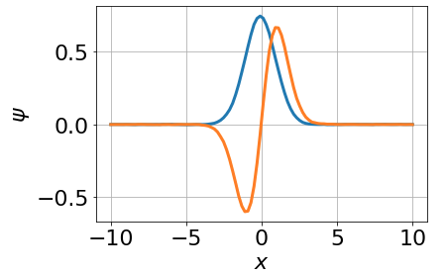
Variational Monte-Carlo
Now we know that any trial wave-function satisfies:
1) Guess an initial trial function
2) Sample a random point and make a small change
3) Calculate the new energy
The result
4) If new E < old E, accept
else, reject the change.
Return to step 2 and loop until convergence (?)

Slide 5

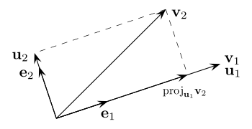
Gram-Schmidt orthogonalization
Simple process to orthogonalize a set of vectors
1) Let’s define the projection of v into u as:
2) Say that we want to orthogonalize the set {v1, v2, v3}.
→ let’s start with v1, and subtract it’s projection from v2, and so on...
3) Normalize the new set {u1, u2, u3} at the end only
(see Wikipedia for better implementations)

Slide 6
Gram-Schmidt orthogonalization: example
V1 = (1, 0, 0)
V2 = (1, 1, 1)
V3 = (2, -1, 0)
1) u1 = (1, 0, 0)
2) proju1(v2) = (1, 0, 0) → u2 = (0, 1, 1)
3) proju1(v3) = (2, 0, 0) & proju2(v3) = (0, -½, -½)
→ u3 = (2, -1, 0) – (2, 0, 0) – (0, -½, -½)
→ u3 = (0, -½, ½)
4) normalize to get

Slide 7
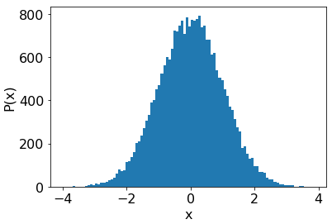
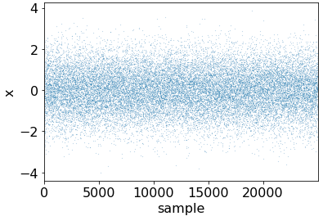
Importance sampling
Small changes in regions where ψ is small, won’t affect E.
It’s better to focus on regions where ψ is large.
The rejection method
Exercise:
Sample a random x
Let P = |ψ(x)|² will be the probability to accept x
    → Normalize P by the maximum value of |ψ(x)|²
Sample an uniform number 0 < q < 1
Accept if q > P
Otherwise try a different x
→ Write a code to sample points with a Gaussian distribution P(x) within the interval -5<x<5.
→ Plot the histogram with
plt.hist(points)

